Slide 1
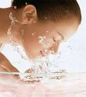
Chapter 6: Skin and the Integumentary system

Slide 2
CHAPTER 6: Vocabulary
Create a foldable for all vocabulary words(pg 112) and Common skin disorders (pg123).

Slide 3
Functions of Skin
Vital in maintaining homeostasis.
Providing a protective covering
Houses sensory receptors
Synthesizes various biochemical and excretes small qualities of wastes.

Slide 4
6.1 Skin and its Tissues
The skin and certain accessory organs make up the integumentary system.
Epidermis- outer layer,composed of stratified squamous epithelium.
Dermis- inner layer, is thicker than the epidermis and contains connective tissues
Subcutaneous (hypodermis)- beneath the skin and NOT a true layer of the skin.

Slide 6
CH 6: QUIZ 1 (20pts)
1. Name the tissues in the inner layer of the skin
2. List the general functions of the skin

Slide 7
Epidermis
However the deepest layer of epidermal cells, called the STRATUM BASALE or stratum germinativum, is close to the dermis and is nourished by dermal blood vessels.
The older cells harden in a process called keratinization.
The epidermis has important protective functions.
It shields the most underlying tissues against excessive water loss, mechanical injury, and the effects of harmful chemicals.
When unbroken, the epidermis also keeps out disease- causing microorganisms (pathogens).

Slide 8
Epidermis
Specilized cells in the epidermis called melanocytes produce melanin, a dark pigment that provides skin color.
Melanin absorbs ultraviolet radiation in sunlight and preventing mutations in the DNA of skin cells and other damaging effects

Slide 9
Skin Color
Skin color is due largely to melanin.
ALL people have the same number of melanoytes in their skin.
Differences in skin color result from differences in the amount of melanin that melanocytes produce and the distribution and size of pigment granules.
Skin color is genetically determined.

Slide 10
Environmental and physiological factors also influence skin color.
For example: a diet high in yellow vegetables may turn skin orang-yellow, because of the foods are rich in pigment called B-carotene.

Slide 11
Check your Recall
What is the function of melanin ?
What factors influence skin color ?
Distinguish between stratum basale and stratum corneum.

Slide 12
Dermis
The boundary between the epidermis and dermis is uneven because of the epidermal ridges project inward and conical projections of dermis, called dermal papillae.
Genes determine fingerprint patterns, but the patterns can change slightly as the fetus moves and presses the forming ridges against the uterine wall.
The dermis binds the epidermis to underlying tissues ( dense connective tissue).

Slide 13
Dermal blood vessels supply nutrients to all skin cells. These blood vessels help regulate body temperature.
Nerve cell processes are scattered throughout the dermis.
Motor processes carry impulses out from the brain or spinal cord to dermal muscles and glands.

Slide 14
SKIN MODEL (50 pts)
Create a 3D model of the skin. The model must include the following :
Hair shaft
Stratum corneum
Stratum basale
Capillary
Touch receptors
Basement membrane
Sebaceous gland
Arrector pili muscle
Sweat gland duct
Hair folicle
Sweat gland
Nerve cell process
Adipose tissue
Blood vessels
Muscle layer below skin

Slide 15
Subcutaneous Layer
Hypodermis- beneath the dermal layer of the skin and consist of loose connective tissue and adipose tissue.
The adipose tissue of the subcutaneous layer insulates, helping to conserve body heat.
Contains major blood vessels that supply the skin and underlying adipose tissue.

Slide 16
CH 6: Quiz 2 (30 pts)
1. What is the function of melanin ?
2. What factors influence skin color ?
3. What kinds of tissue make up the dermis ?

Slide 17
6.2 Accessory Organs of the Skin
Nails
Protective coverings on the ends of the fingers and toes.
Each nail consist of a nail plate that coverlies a surface of skin called the nailbed.
The whightish, thickened, halfmoon shaped region (luna) at the base of the nail plate.

Slide 18
NAILS

Slide 19
Nails

Slide 20
Hair
Hair is present all over the skin surfaces except the palms, soles,lips, nipples, and parts of the external reproductive organs.
Each hair develops from a group of epidermal cells at the base of a tubelike depression called a hair follicle.
Follicle extends from the surface into the dermis and contains the hair root.

Slide 21
Hair

Slide 22
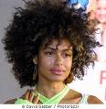
Hair

Slide 23
Sweat Glands
Are exocrine glands that are widespread in the skin.
Each gland consist of tiny tube that originate as a ball-shaped coil in the deeper dermis.
The most numerous sweat glands, the eccrine glands responds throughout life to body temperature elevated by environment heat or physical exercise.
Glands are common on the forehead, neck, and back.

Slide 24
Sweat Glands
The fluid sweat that the eccrine gland secretes is carried away in a duct that opens called pores.
Sweat is mostly water, but also contains small quantities of salt and wastes, such as urea and uric acid.
Other sweat glands:
Apocrine glands- become active at puberty
Most numerous in the axillary regions and groin and hair follicles

Slide 25
Sebaceous Glands
Contains a specialized epithelial cells and are usually associated with hair follicles.
They are holocrine glands that secrete an oily mixture of fatty material and cellular debris called sebum.

Slide 26
6.3 Regulation of Body Temperture
Normally, the tempature of deeper body parts remains close to a set point of 37C
The skin plays a key role in the homeostatic mechanism that regulates body temp.
Heat is a product of cellular metabolism, thus the more active cells of the body.
As body temperature rises, nerve impulse stimulate structures in the skin and other organs to release heat.

Slide 27
S
Example: during physical exercise, active muscles release heat, which the blood carries away. The warmed blood reaches the part of the brain (the hypothalmus ) that controls the body temperature set point, which signals muscles

Slide 28
6.4 Healing of Wounds
A wound and the area surrounding it usually become red and painfully swollen…this is a result of inflammation which imay s a normal response to injury or stress.
Inflamed skin may become reddedned, warm, swollen, and painful to touch.
The specific events in healing depend on the nature of the injury

Slide 29
Topic of Interest
Read BURNS on
pg. 121
Write ½ page summary about the article.

Slide 30
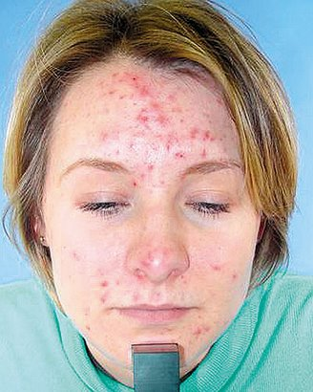
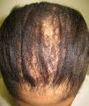
Common Skin Disorders pg.123
Acne
Alopecia

Slide 31
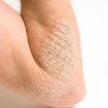
Eczema
Herpes

Slide 32
Boil
Keloid

Slide 33
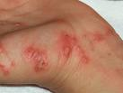
Mole
Scabies

Slide 34
Warts
Impetigo

